Slide 1


Azərbaycan Dövlət Neft və Sənaye Universiteti
Calculus
Single Variable

Slide 2
Precalculus:
Functions and Their Graphs

Slide 3
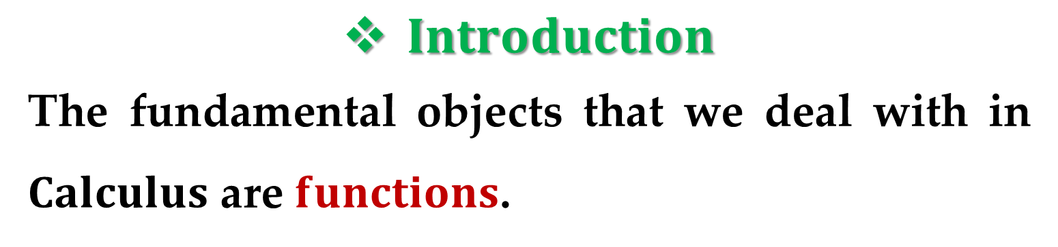
$Introduction$
The fundamental objects that we deal with in $Calculus$ are $functions$.
We stress that a function can be represented in different ways:
by an equation,
in a table,
by a graph,
or even in words.

Slide 4
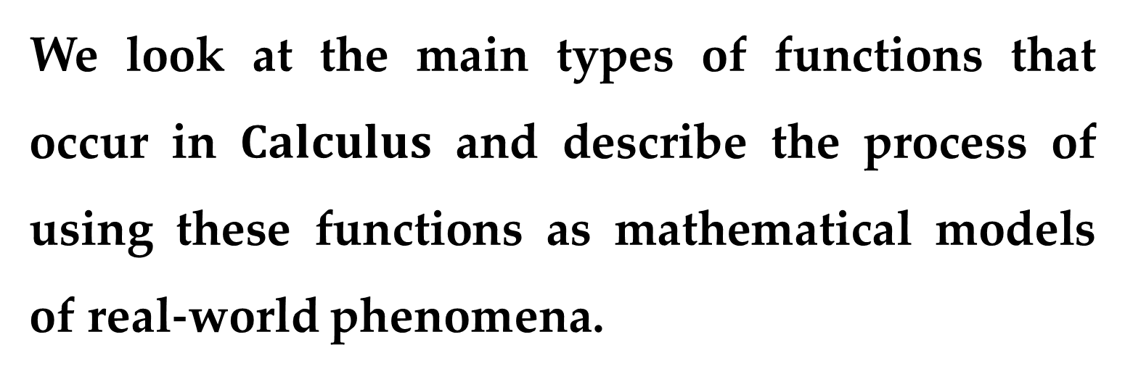
We look at the main types of functions that occur in $Calculus$ and describe the process of using these functions as mathematical models of real-world phenomena.
Functions arise whenever one quantity depends on another.
There are four ways to represent a function.
So, we consider the following four situations.

Slide 5
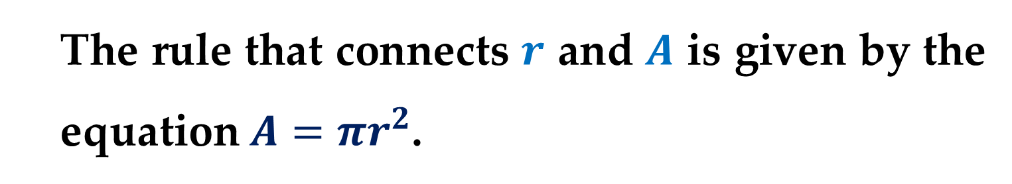
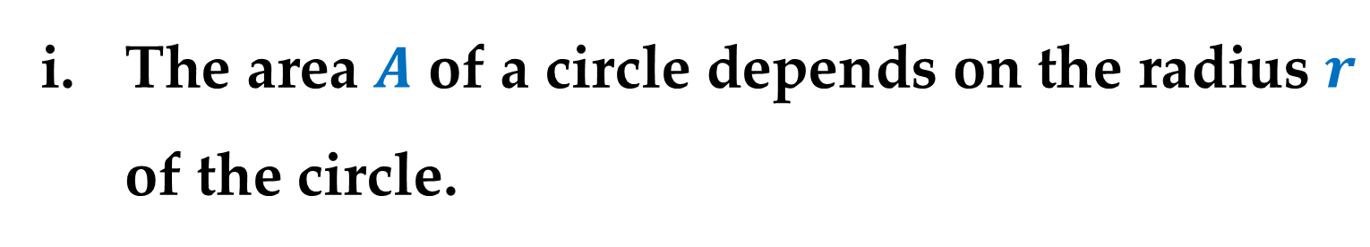
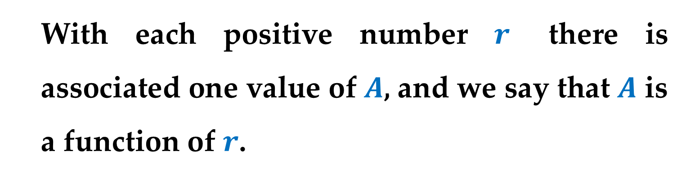
The area $A$ of a circle depends on the radius $r$ of the circle.
The rule that connects $r$ and $A$ is given by the equation $A=πr^{2}$.
With each positive number $r$ there is associated one value of $A$, and we say that $A$ is a function of $r$.

Slide 6
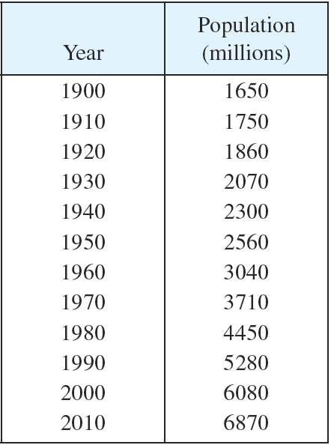
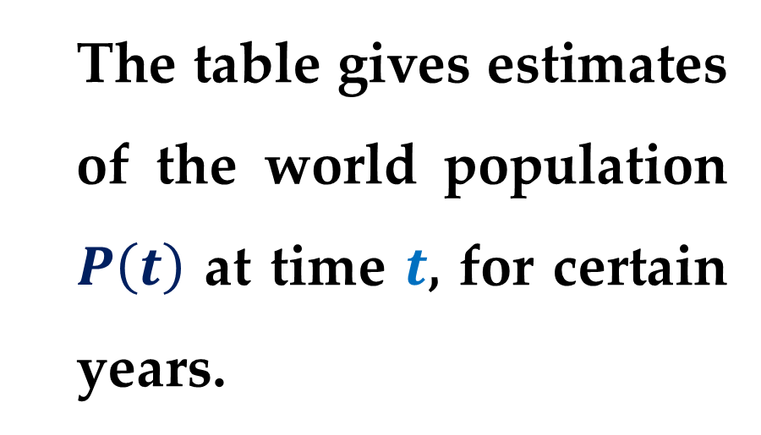
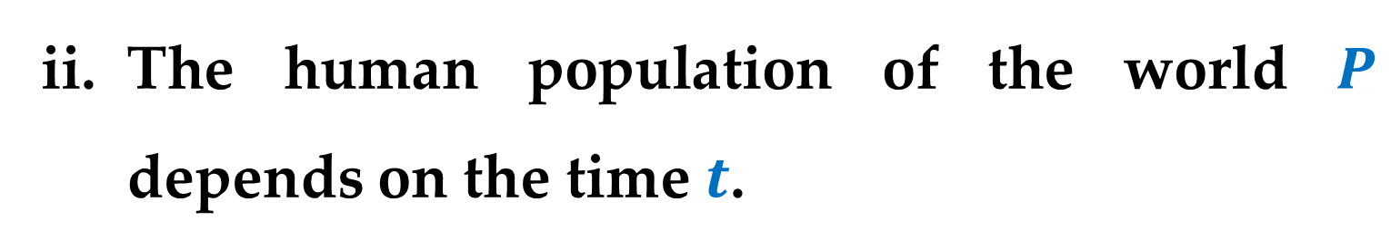
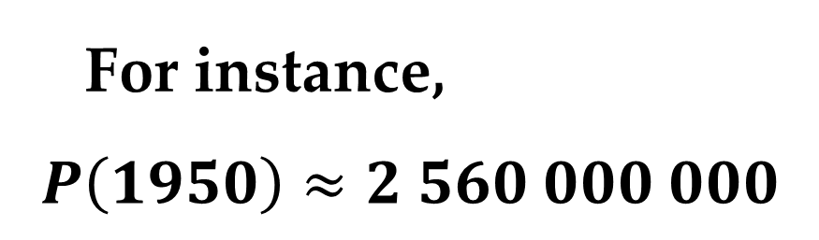
The human population of the world $P$ depends on the time $t$.
The table gives estimates of the world population $P\left(t\right)$ at time $t$, for certain years.
For instance,
$$P\left(1950\right)≈2 560 000 000$$

Slide 7
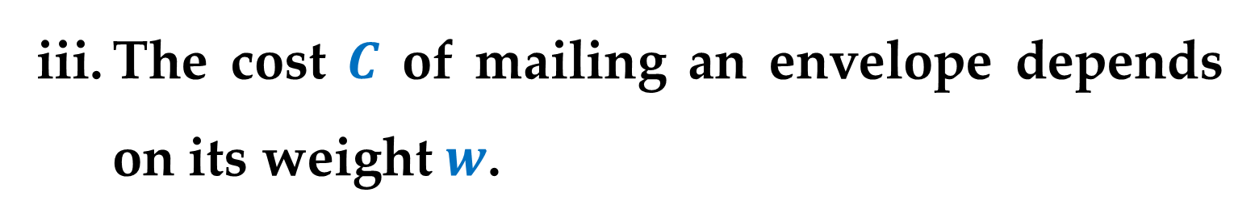
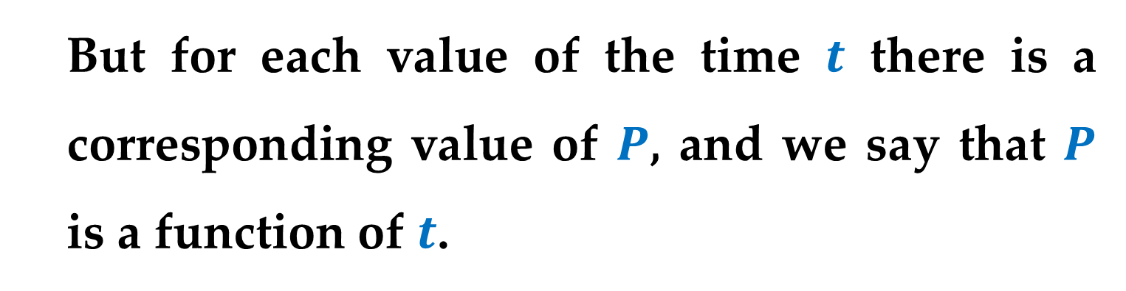
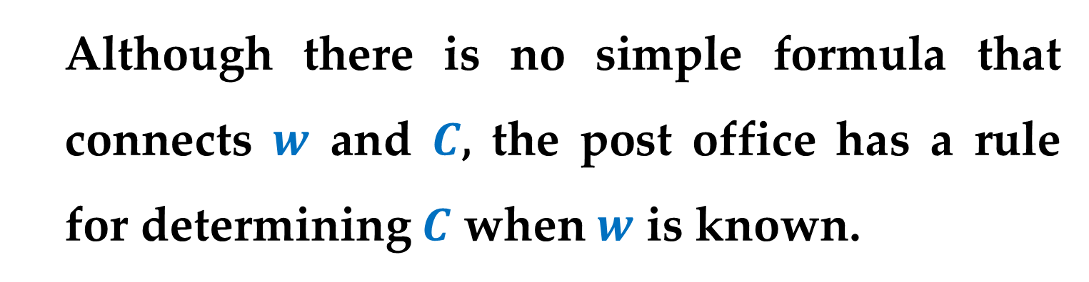
But for each value of the time $t$ there is a corresponding value of $P$, and we say that $P$ is a function of $t$.
The cost $C$ of mailing an envelope depends on its weight $w$.
Although there is no simple formula that connects $w$ and $C$, the post office has a rule for determining $C$ when $w$ is known.

Slide 8
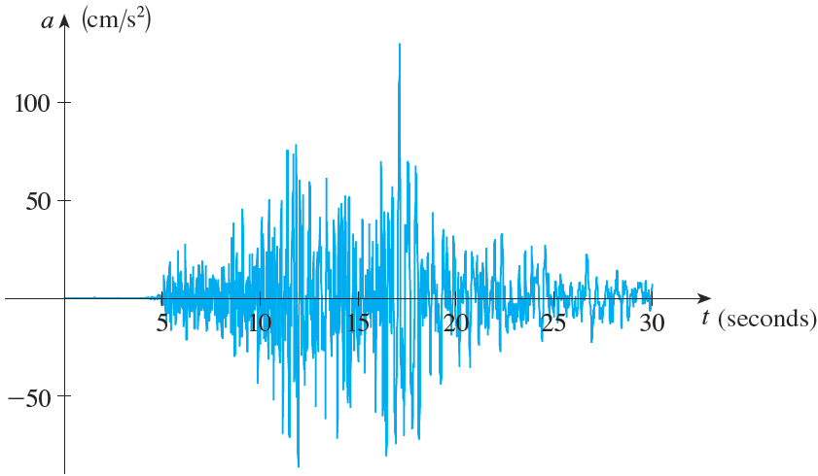
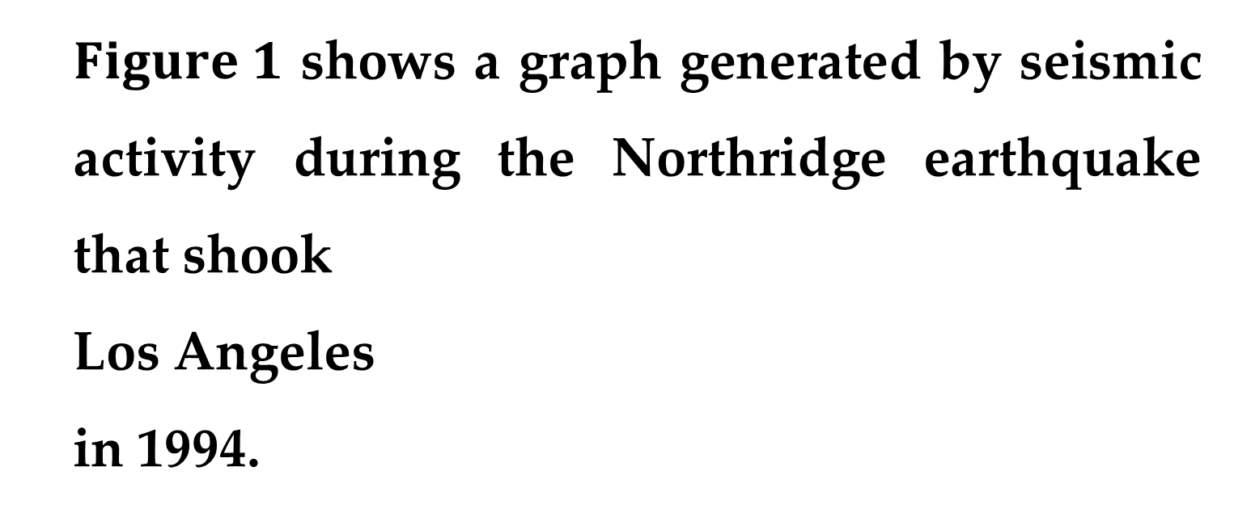
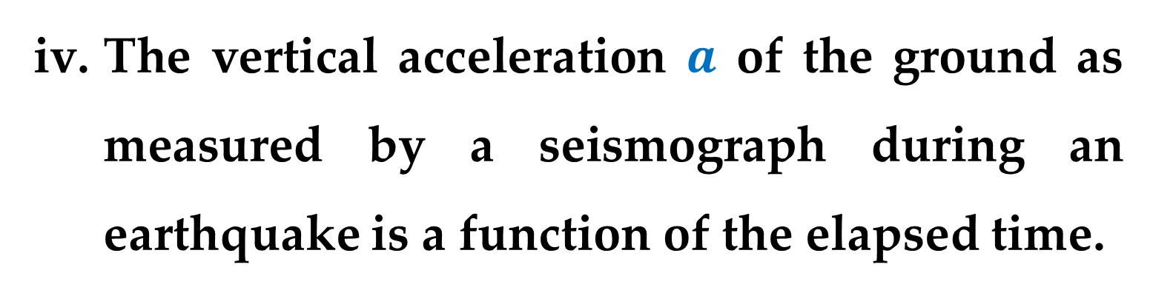
The vertical acceleration $a$ of the ground as measured by a seismograph during an earthquake is a function of the elapsed time.
$Figure 1$ shows a graph generated by seismic activity during the Northridge earthquake that shook
Los Angeles
in 1994.

Slide 9
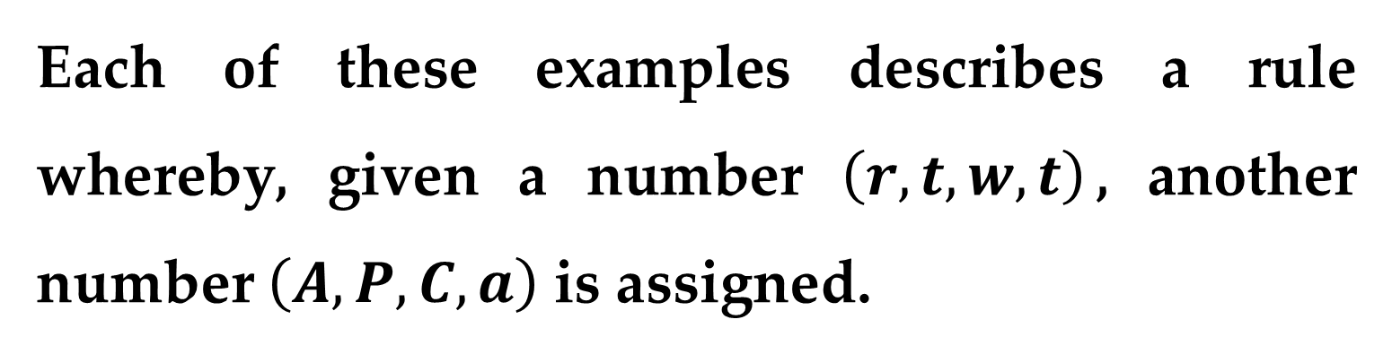
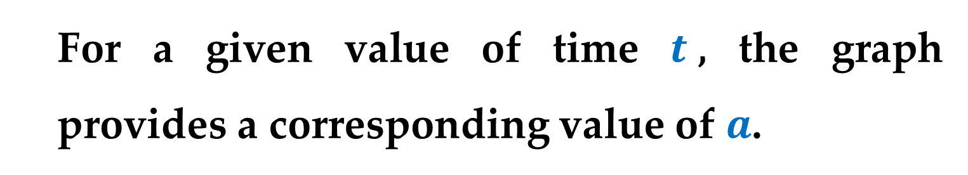
For a given value of time $t$, the graph provides a corresponding value of $a$.
Each of these examples describes a rule whereby, given a number $\left(r, t, w, t\right)$, another number $\left(A, P, C, a\right)$ is assigned.
In each case we say that the second number is a function of the first number.

Slide 10
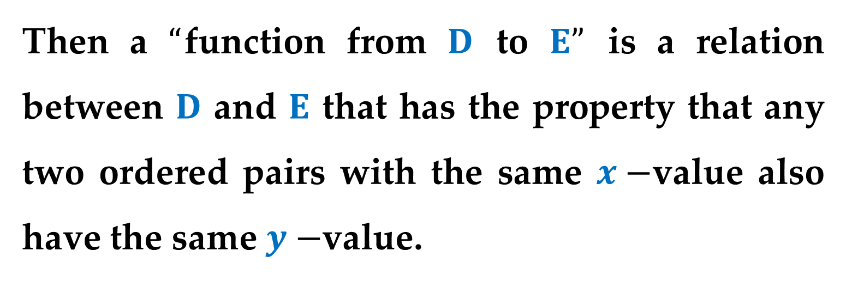
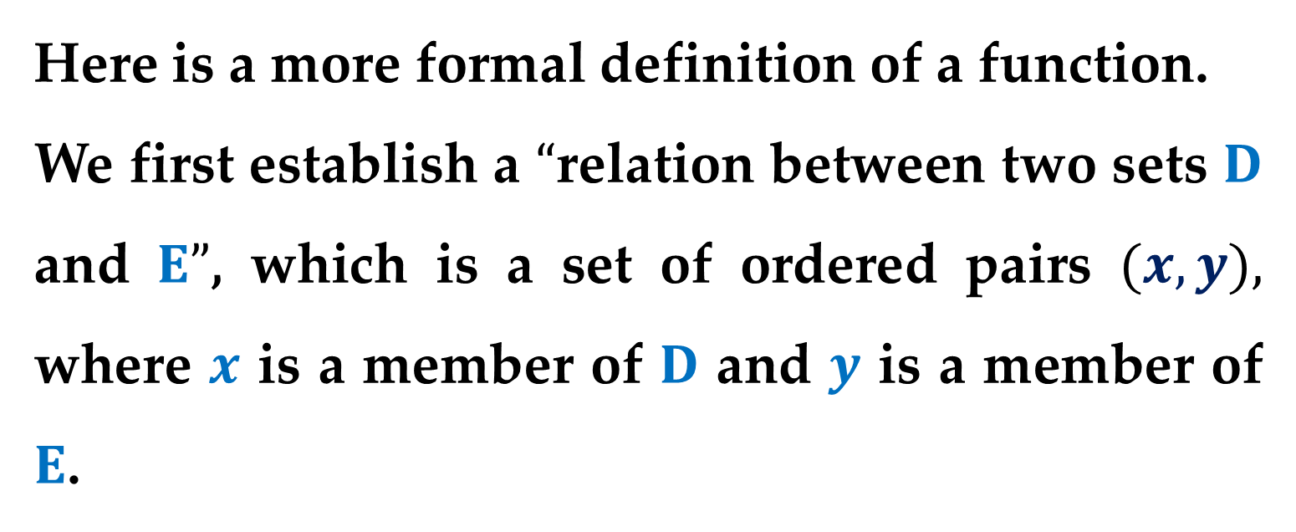
Here is a more formal definition of a function.
We first establish a $“$relation between two sets $D$ and $E”$, which is a set of ordered pairs $(x,y),$ where $x$ is a member of $D$ and $y$ is a member of $E$.
Then a $“$function from $D$ to $E”$ is a relation between $D$ and $E$ that has the property that any two ordered pairs with the same $x−$value also have the same $y−$value.

Slide 11
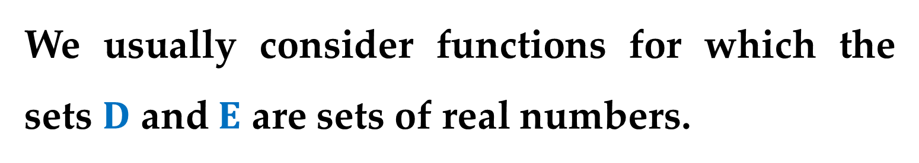
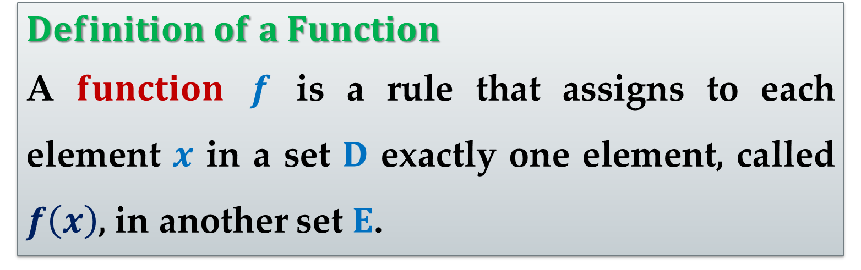
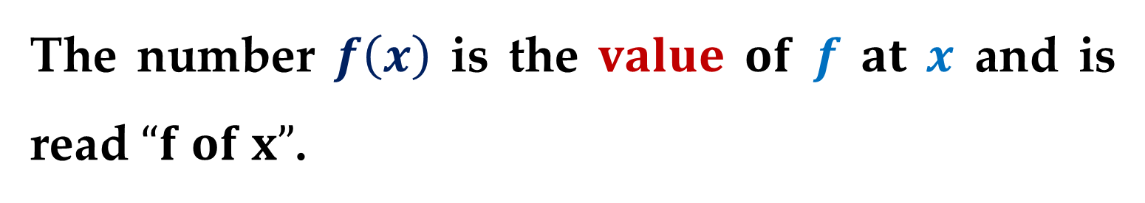

$$Definition of a Function$$
A $function$ $f$ is a rule that assigns to each element $x$ in a set $D$ exactly one element, called $f\left(x\right)$, in another set $E$.
We usually consider functions for which the sets $D$ and $E$ are sets of real numbers.
The set $D$ is called the $domain$ of the function.
The number $f\left(x\right)$ is the $value$ $of$ $f$ $at$ $x$ and is read $“f of x”$.

Slide 12
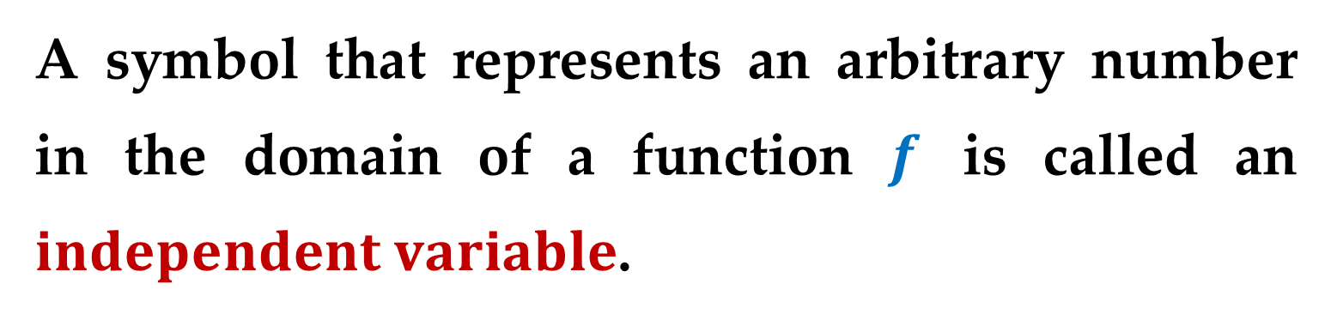
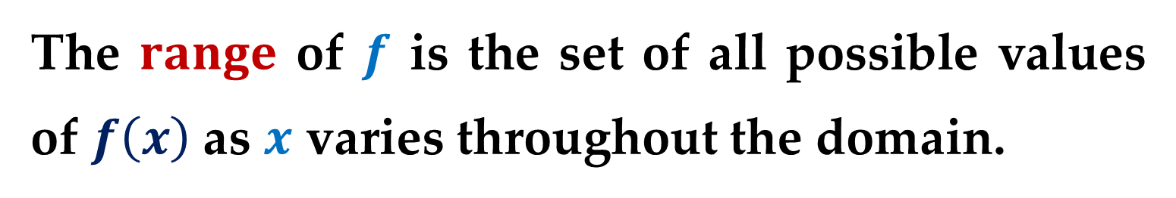
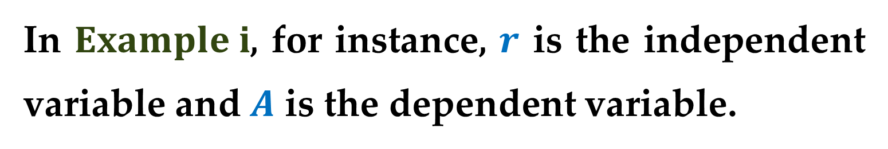
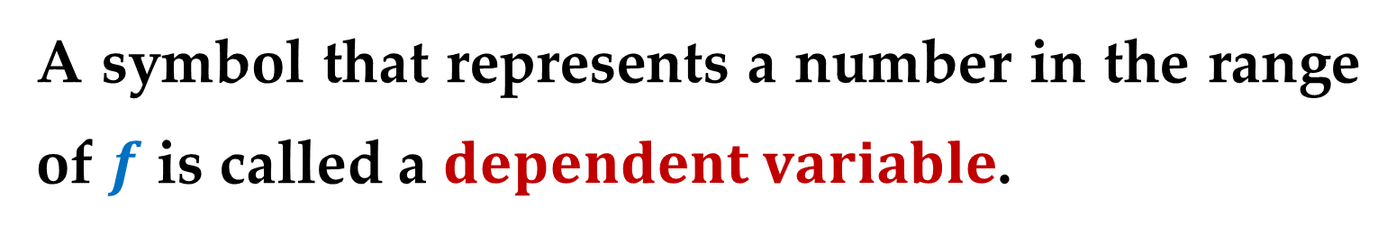
The $range$ of $f$ is the set of all possible values of $f\left(x\right)$ as $x$ varies throughout the domain.
A symbol that represents an arbitrary number in the domain of a function $f$ is called an $independent variable$.
A symbol that represents a number in the range of $f$ is called a $dependent variable$.
In $Example i$, for instance, $r$ is the independent variable and $A$ is the dependent variable.

Slide 13
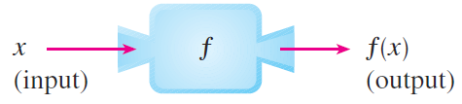
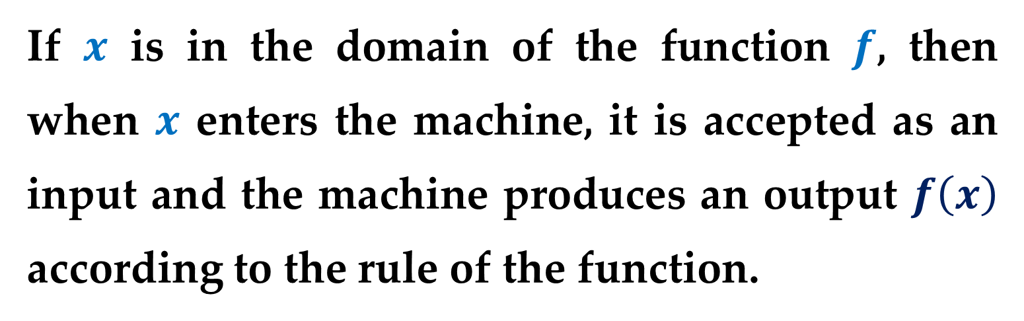
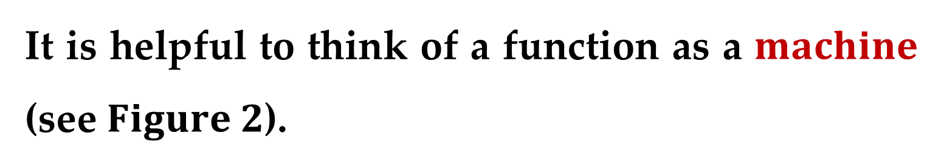
It is helpful to think of a function as a $machine$ (see $Figure 2$).
If $x$ is in the domain of the function $f$, then when $x$ enters the machine, it is accepted as an input and the machine produces an output $f\left(x\right)$ according to the rule of the function.
Thus we can think of the domain as the set of all possible inputs and the range as the set of all possible outputs.

Slide 14
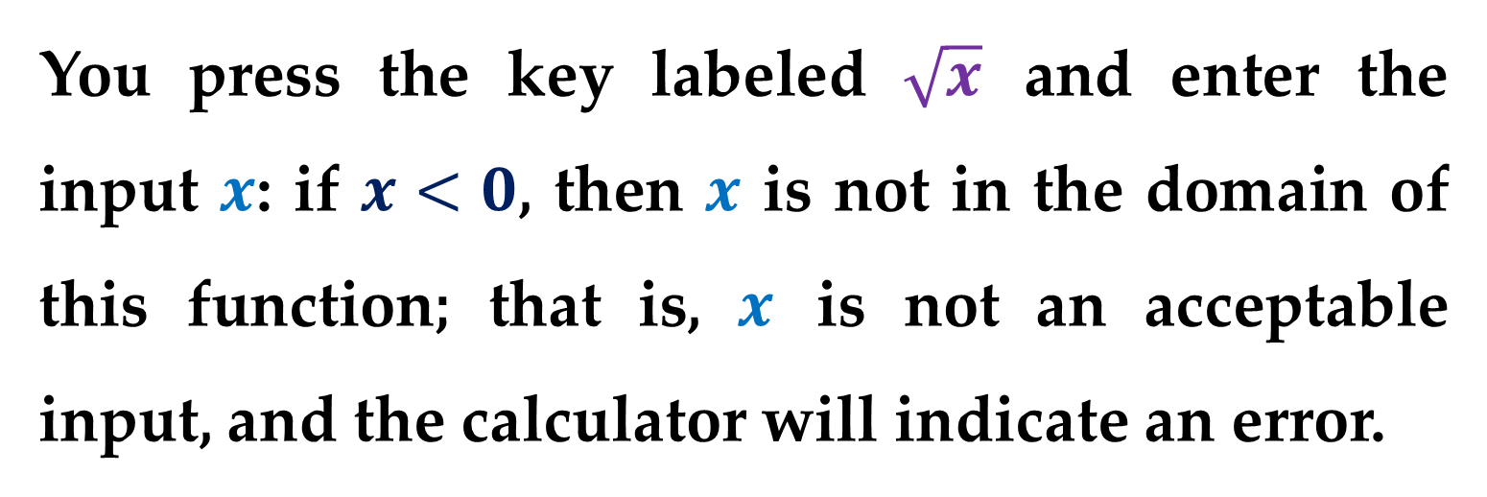
The preprogrammed functions in a calculator are good examples of a function as a machine.
For example, the square root key on your calculator computes such a function.
You press the key labeled $\sqrt{x}$ and enter the input $x$: if $x<0$, then $x$ is not in the domain of this function; that is, $x$ is not an acceptable input, and the calculator will indicate an error.

Slide 15
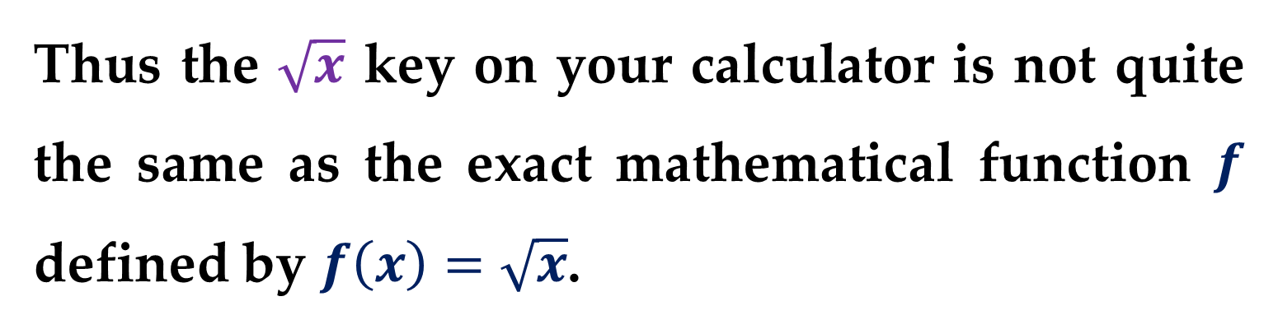
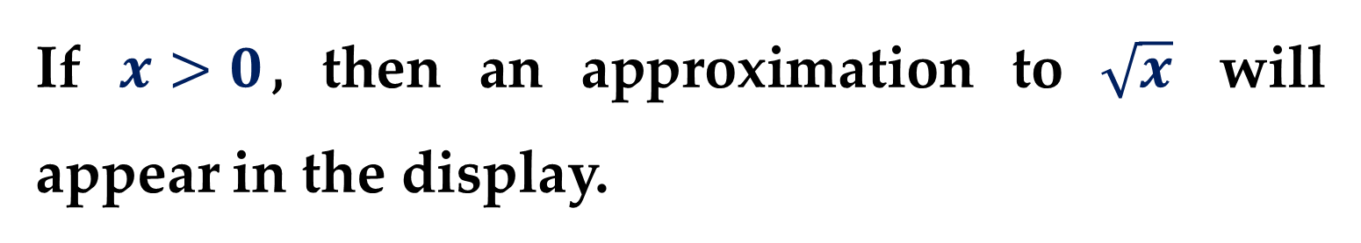
If $x>0$, then an approximation to $\sqrt{x}$ will appear in the display.
Thus the $\sqrt{x}$ key on your calculator is not quite the same as the exact mathematical function $f$ defined by $f\left(x\right)=\sqrt{x}$.

Slide 16
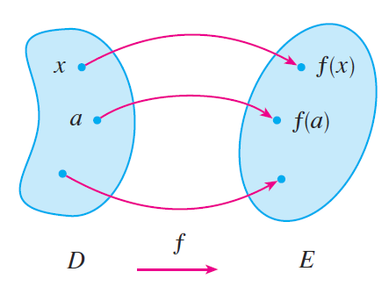
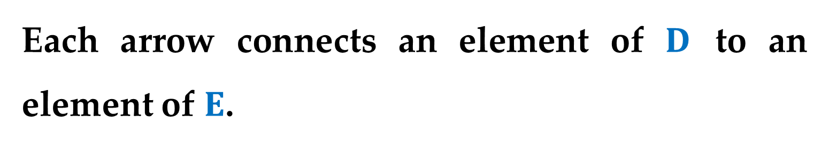
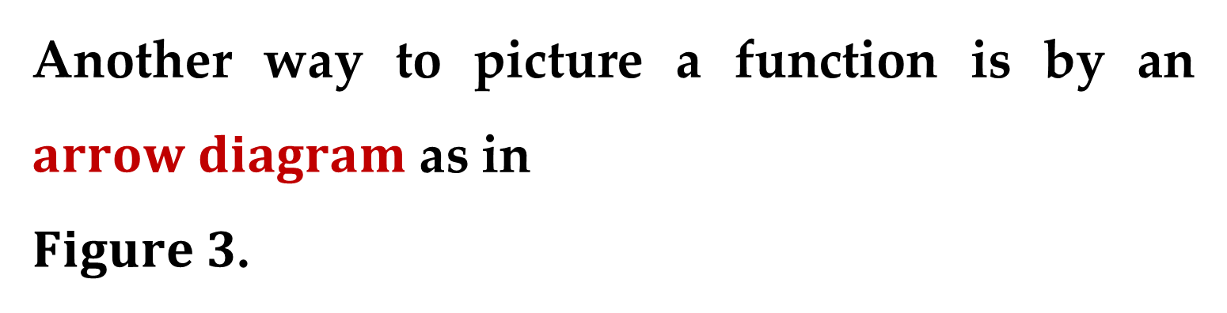
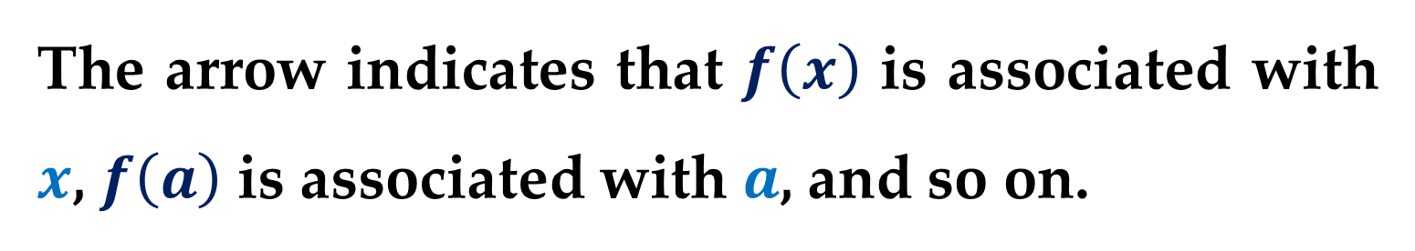
Another way to picture a function is by an $arrow diagram$ as in
$Figure 3$.
Each arrow connects an element of $D$ to an element of $E$.
The arrow indicates that $f\left(x\right)$ is associated with $x$, $f\left(a\right)$ is associated with $a$, and so on.

Slide 17
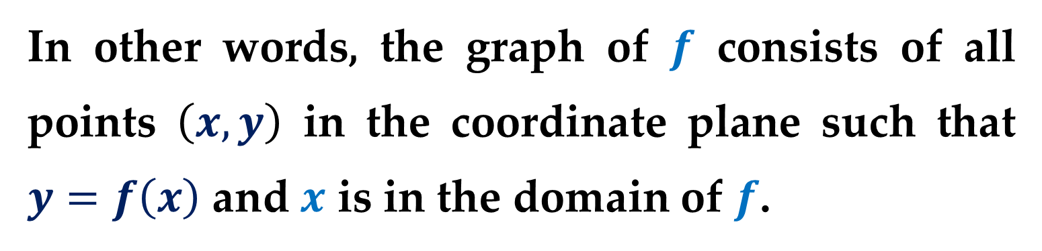
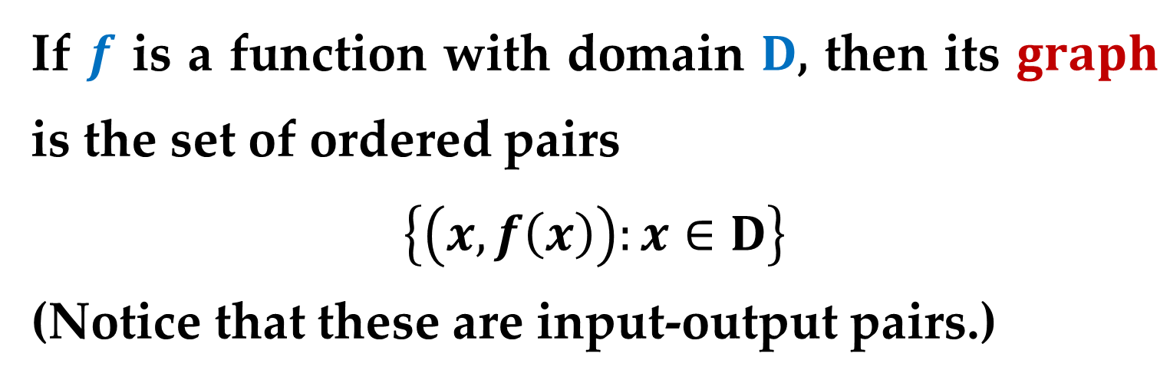
The most common method for visualizing a function is its graph.
If $f$ is a function with domain $D$, then its $graph$ is the set of ordered pairs
$$\left\{\left(x,f\left(x\right)\right):x∈D\right\}$$
(Notice that these are input-output pairs.)
In other words, the graph of $f$ consists of all points $\left(x,y\right)$ in the coordinate plane such that $y=f\left(x\right)$ and $x$ is in the domain of $f$.

Slide 18
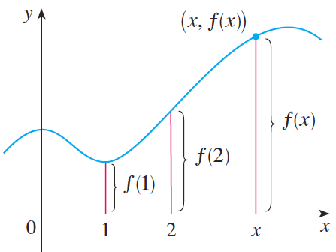
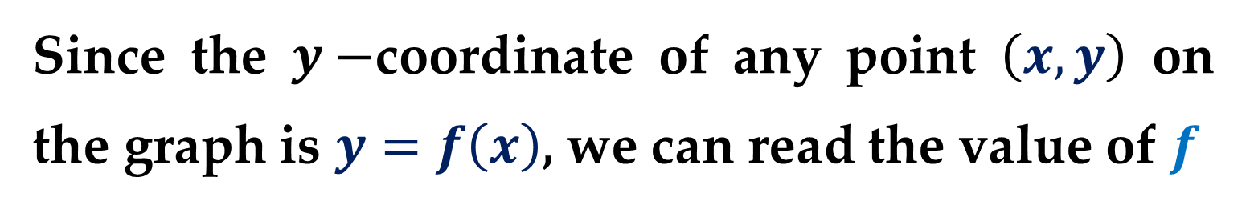
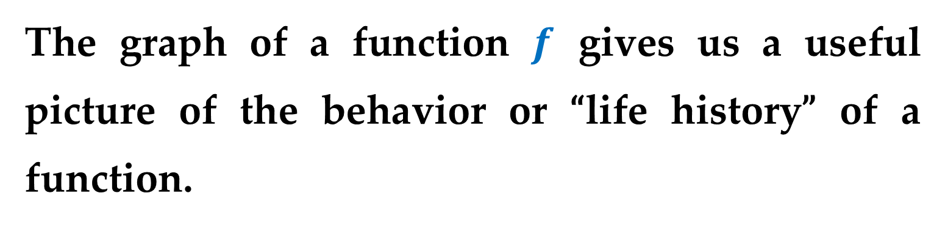
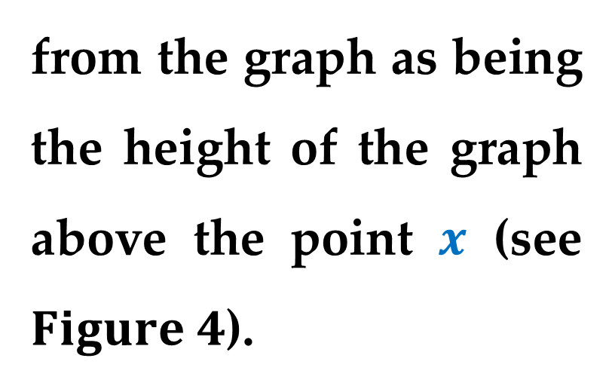
The graph of a function $f$ gives us a useful picture of the behavior or “life history” of a function.
Since the $y−$coordinate of any point $\left(x,y\right)$ on the graph is $y=f\left(x\right)$, we can read the value of $f$
from the graph as being the height of the graph above the point $x$ (see $Figure 4$).

Slide 19
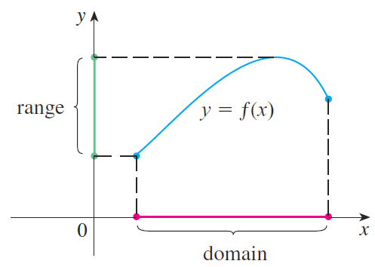
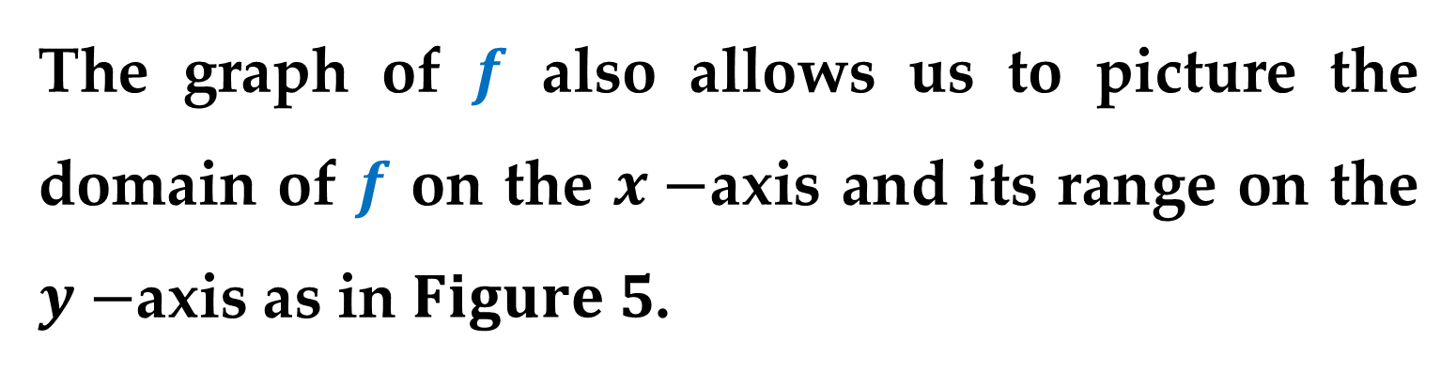
The graph of $f$ also allows us to picture the domain of $f$ on the $x−$axis and its range on the $y−$axis as in $Figure 5$.

Slide 20
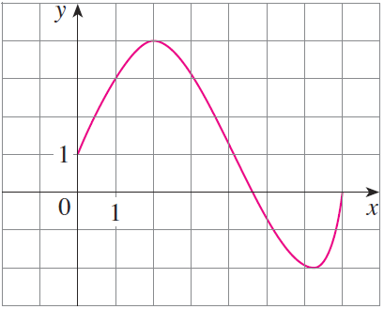
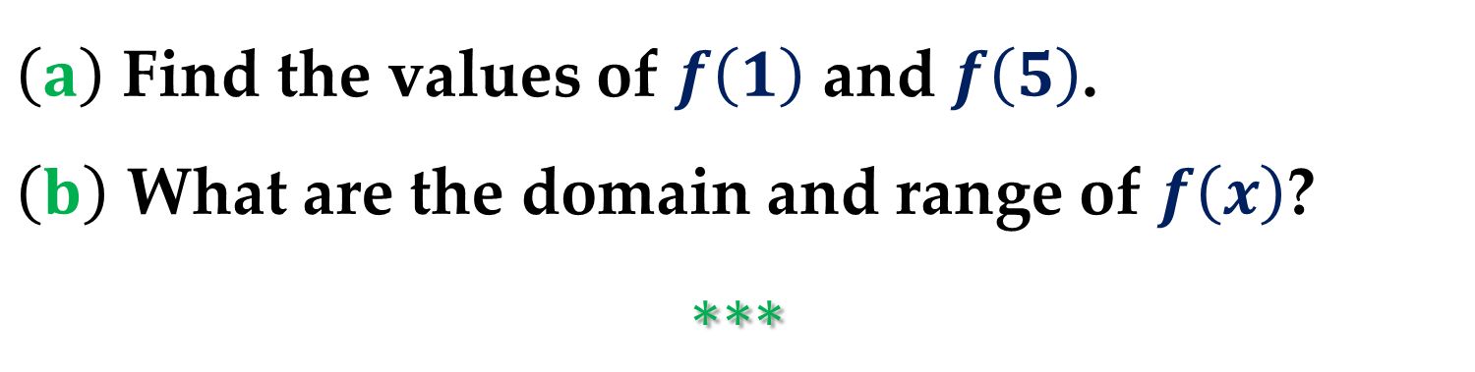
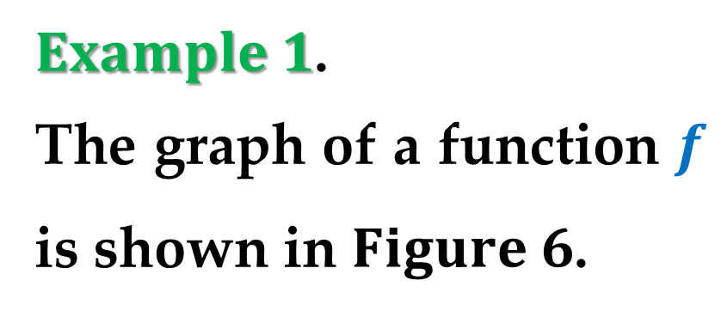
$Example 1$.
The graph of a function $f$ is shown in $Figure 6$.
$\left(a\right)$ Find the values of $f\left(1\right)$ and $f\left(5\right)$.
$\left(b\right)$ What are the domain and range of $f\left(x\right)$?
$$∗∗∗$$

Slide 21
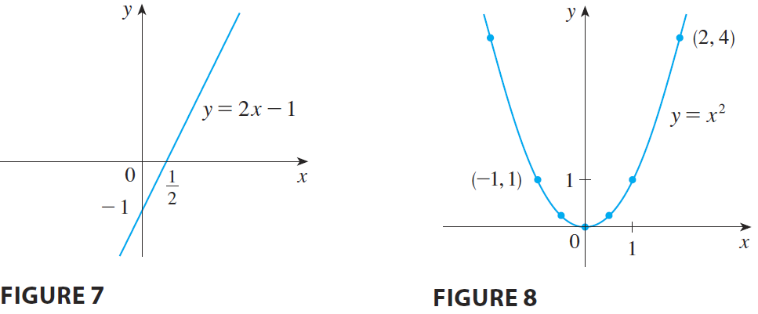
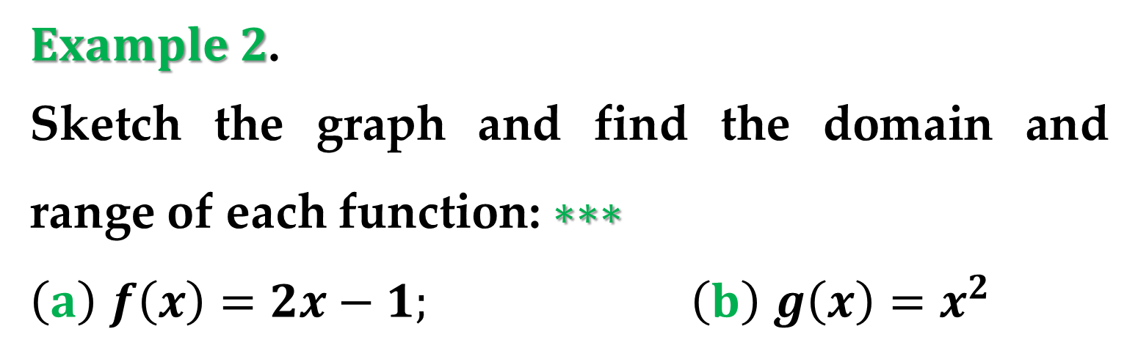
$Example 2$.
Sketch the graph and find the domain and range of each function: $∗∗∗$
$\left(a\right)$ $f\left(x\right)=2x−1;$ $\left(b\right)$ $g\left(x\right)=x^{2}$

Slide 22
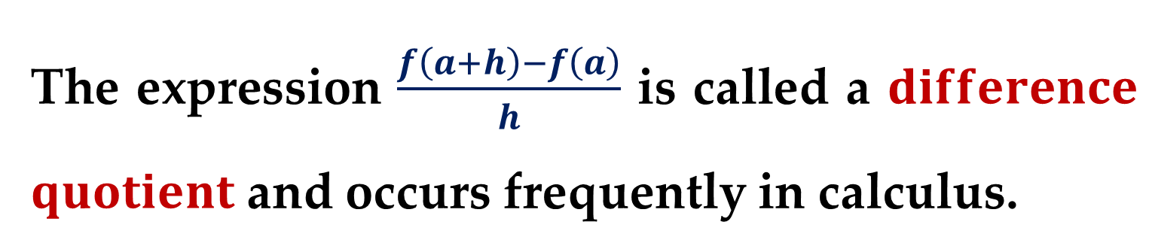


$Example 3$.
If $f\left(x\right)=2x^{2}−5x+1$ and $h≠0$, evaluate $∗∗∗$
$$\frac{f\left(a+h\right)−f\left(a\right)}{h}$$
The expression $\frac{f\left(a+h\right)−f\left(a\right)}{h}$ is called a $difference$ $quotient$ and occurs frequently in calculus.
As we will see later, it represents the average rate of change of $f\left(x\right)$ between $a$ and $a+h$.

Slide 23

Functions can be specified in a variety of ways.
We will concentrate primarily on functions that are given by equations involving the dependent and independent variables.
For instance$,$ the equation
$x^{2}+2y=1$ – $equation in implicit form$
defines $y,$ the dependent variable$,$ as a function of $x,$ the independent variable.

Slide 24


To $evaluate$ this function (i.e. to find the $y−$value that corresponds to a given $x−$value)$,$ it is convenient to isolate $y$ on the left side of the equation as follows:
$y=\frac{1}{2}\left(1−x^{2}\right)$ – $equation in explicit form$
Using $f$ as the name of the function$,$ you can write this equation as
$f\left(x\right)=\frac{1}{2}\left(1−x^{2}\right) \text{ –}$ $function notation$

Slide 25



The original equation $x^{2}+2y=1$ $implicitly$ defines $y$ as a function of $x$.
When you solve the equation for $y,$ you are writing the equation in $explicit$ form.
One can use other symbols to name independent and dependent variables:
$$f\left(x\right)=x^{2}−4x+7$$
$$f\left(t\right)=t^{2}−4t+7$$
$$g\left(s\right)=s^{2}−4s+7$$

Slide 26


$Domain and Range of a Function$
The domain of a function can be described $explicitly,$ or it may be described $implicitly$ by an equation used to define the function.
For example$,$ the function given by
$$f\left(x\right)=\frac{1}{x^{2}−4}, 4≤x≤5$$
has an explicitly defined domain given by
$$\left\{x:4≤x≤5 \right\}$$

Slide 27

On the other hand$,$ the function given by
$$g\left(x\right)=\frac{1}{x^{2}−4}$$
has an implied domain that is the set
$$\left\{x∈R: x≠±2\right\}$$

Slide 28


$Example 4. Finding Domain and Range$
$$of a Function$$
$a$. The domain of the function
$$f\left(x\right)=\sqrt{x−1}$$
is the set of all $x−$values for which $x−1≥0,$ which is the interval $[1,∞)$.
To find the range$,$ observe that $f\left(x\right)=\sqrt{x−1}$ is never negative.

Slide 29


So$,$ the range is the interval $[0,∞),$ as indicated in $Figure 9(a)$.

Slide 30



$b$. The domain of the function (as shown in $Figure 9(b)$) $g\left(x\right)=\sqrt{4−x^{2}}$ is the set of all values for which
$4−x^{2}≥0$, or $x^{2}≤4$.
So, the domain of $g$
is the interval $\left[−2,2\right]$.

Slide 31



$Example 4$. $\left(continued\right)$
To find the range, observe that $g\left(x\right)$ is never negative and is at most $2$.
So, the range is the interval $\left[0, 2\right]$, as shown in $Figure 9\left(b\right)$ above.
Note that the graph of $g$ is a semicircle of radius $2$.

Slide 32


$Example 5. A Function Defined by More$
$$than One Equation$$
Determine the domain and range of the function
$$f\left(x\right)=\left\{\begin{aligned}1−x, x<1 \\ \sqrt{x−1}, x≥1\end{aligned}\right.$$
$Solution$
Becaufe $f$ is defined for $x<1$ and $x≥1,$ the domain is the entire set of real numbers.

Slide 33



$Solution$ (continued)
On the portion of the domain for which $x≥1,$ the function behaves as in $Example 4(a)$.
For $x<1,$ the values of $1−x$ are positive.
So, the range of the function $f$ is the interval $[0,∞)$.

Slide 34


$Definition$
A function from $D$ to $E$ is one-to-one when to each $y−$value in the range there corresponds exactly one $x−$value in the domain.
$Definition. Vertical Line Test$
A graph in the coordinate plane is the graph of a function of $x$ if and only if no vertical line intersects the graph at more than one point.

Slide 35


For example, in $Figure 10\left(a\right)$, you can see that the graph does not define $y$ as a function of $x$ because a vertical line intersects the graph twice, whereas in $Figures 10\left(b\right)$ and $10\left(c\right)$, the graphs do define $y$ as a function of $x$.

Slide 36


$Figure 11$ shows the graphs of six basic functions. You should be able to recognize these graphs at once.

Slide 37


$Figure 11$. The graphs of eight basic functions (continued)

Slide 38



$Transformations of Functions$
Some families of graphs have the same basic shape.
For example$,$ compare the graph of $y=x^{2}$ with the graphs of the four other quadratic functions shown in $Figure 12$.
Each of the graphs in $Figure 12$ is a transformation of the graph of $y=x^{2}$.

Slide 39


Slide 40

The three basic types of transformations illustrated by these graphs are
Vertical shifts$;$
Horizontal shifts$;$
Reflections$.$

Slide 41




$Basic Types of Transformations$ $\left(c>0\right)$
Original graph: $y=f(x)$
Horizontal shift $c$ units to the right:
$y=f(x−c)$
Horizontal shift $c$ units to the left:
$y=f(x+c)$
Vertical shift $c$ units downward:
$y=f\left(x\right)−c$

Slide 42




$Basic Types of Transformations$ $\left(c>0\right)$
Vertical shift $c$ units upward:
$y=f(x)+c$
Reflection (about the $x−$axis): $y=−f(x)$
Reflection (about the $y−$axis): $y=f(−x)$
Reflection (about the origin): $y=−f(−x)$

Slide 43



$Classifications and Combinations$
$$of Functions$$
The modern notion of a function is derived from the efforts of many 17th
and 18th century mathematicians.
Of particular note was $Leonhard Euler$, to whom we are indebted for the function notation $y=f(x)$.

Slide 44

By the end of the 18th century, mathematicians and scientists had concluded that many real-world phenomena could be represented by mathematical models taken from a collection of functions called $elementary functions$.

Slide 45

Elementary functions fall into three categories.
Algebraic functions
$$(polynomial, radical, rational)$$
Trigonometric functions
$$(sine, cosine, tangent, etc.)$$
Exponential and logarithmic functions

Slide 46


The most common type of algebraic function is a $polynomial$ function:
$$f\left(x\right)=a_{n}x^{n}+a_{n−1}x^{n−1}+…+a_{1}x+a_{0}$$
where $n$ is a nonnegative integer.
The numbers $a_{n},a_{n−1},…,a_{1},a_{0}$ are $coefficients,$ with $a_{n}$ the $leading coefficient$ and $a_{0}$ the $constant term$ of the polynomial function.

Slide 47


If $a_{n}≠0$ then $n$ is the degree of the polynomial function (the zero polynomial $f\left(x\right)≡0$ is not assigned a degree).
For polynomial functions of low degree$,$ the following simpler forms are often used ($a≠0$):
$$f\left(x\right)=a − constant function$$
$$f\left(x\right)=ax+b −linear function$$
$$f\left(x\right)=ax^{2}+bx+c −quadratic function$$
$$f\left(x\right)=ax^{3}+bx^{2}+cx+d −cubic function$$

Slide 48


Although the graph of a non-constant polynomial function can have several turns$,$ eventually the graph will rise or fall without bound as $x$ moves to the right or left.
Whether the graph of
$$f\left(x\right)=a_{n}x^{n}+a_{n−1}x^{n−1}+…+a_{1}x+a_{0}$$
eventually rises or falls can be determined by the function$’$s degree (odd or even) and by the leading coefficient $a_{n},$ as indicated in $Figure 13$.

Slide 49


Slide 50


Slide 51


A $rational function$ can be written as the quotient of two polynomials.
Specifically$,$ a function is rational if it has the form:
$$f\left(x\right)=\frac{p(x)}{q(x)}, q(x)≠0$$
where $p(x)$ and $q(x)$ are polynomials.
Polynomial and rational functions are examples of $algebraic functions$.

Slide 52


An $algebraic function$ of $x$ is one that can be expressed as a finite number of
sums
differences
multiples
quotients
radicals
involving some degree of $x$ (i.e. $x^{n}$).
Functions that are not algebraic are $transcendental$.

Slide 53

Two functions can be combined in various ways to create new functions.
For example$,$ given $f(x)=2x−3$ and $g\left(x\right)=x^{2}+1,$ you can form the functions shown below:
$$\left(f±g\right)\left(x\right)=f\left(x\right)±g\left(x\right)=(2x−3)±(x^{2}+1)$$
$$\left(f∙g\right)\left(x\right)=f\left(x\right)g\left(x\right)=(2x−3)(x^{2}+1)$$
$$\left(\frac{f}{g}\right)\left(x\right)=\frac{f\left(x\right)}{g\left(x\right)}=\frac{2x−3}{x^{2}+1}$$

Slide 54


You can combine two functions in yet another way$,$ called $composition$.
The resulting function is called a $composite$ $function$.
$Definition. Composite Function$
Let $f$ and $g$ be functions.
The function given by $\left(f∘g\right)\left(x\right)=f(g\left(x\right))$ is called the $composite$ of $f$ and $g$.

Slide 55



The domain of $f∘g$ is the set of all $x$ in the domain of $g$ such that $g(x)$ is in the domain of $f$ (see $Figure 14$).
$Remark$
The composite of $f$ and $g$ may not be equal to the composite of $g$ with $f$.

Slide 56

$Example 6. Finding Composite Functions$
Given $f\left(x\right)=2x−3$ and $g\left(x\right)=\cos{x},$ find each composite function: $∗∗∗$
$a$. $f∘g$ $b$. $g∘f$

Slide 57


$Definition$
The $zeros$ of a function $f$ are the solutions of the equation $f\left(x\right)=0$.
For example$,$ the function $f(x)=x−4$ has a zero at $x=4$ because $f\left(4\right)=0$.

Slide 58

$Definition$
A function is $even$ if its graph is symmetric with respect to the $y−$axis.
A function is $odd$ if its graph is symmetric with respect to the origin.

Slide 59

$Test for Even and Odd Functions$
The function $y=f(x)$ is even if
$$f\left(−x\right)=f(x)$$
The function $y=f(x)$ is odd if
$$f\left(−x\right)=−f(x)$$

Slide 60

$Remark$
Except for the constant function $f(x)≡0$ the graph of a function of $x$ cannot have symmetry with respect to the $x−$axis because it then would fail the $Vertical Line Test$ for the graph of the function.

Slide 61

$Example 7. Even and Odd Functions and$
$$Zeros of Functions$$
Determine whether each function is even$,$ odd$,$ or neither.
Then find the zeros of the function.
$a$. $f\left(x\right)=x^{3}−x$ $b$. $g\left(x\right)=\frac{1}{x^{2}}$
$c$. $h\left(x\right)=−x^{2}−x−1$
$$∗∗∗$$

Slide 62

$Solution$

Slide 63
Thank you for attention

